Slide 1
Unit 4
Pointers and Polymorphism in C++

Slide 2
Pointer Arithmetic
pointer is an address which is a numeric value therefore, you can perform arithmetic operations on a pointer just as you can a numeric value.
There are four arithmetic operators that can be used on pointers:
Int *p ,* q , a; p = &a;
++ (increment) p++
-- (Decrement) p--
+ (Addition) p + 3 ,
- (Subtraction) p -5 , p – q
Not allowed - * and /

Slide 3
Pointer Arithmetic - ++ (Increment)
Incrementing Pointer
If we increment a pointer by 1, the pointer will start pointing to the immediate next location.
Value of the pointer will get increased by the size of the data type to which the pointer is pointing.
int number=50;
int *p; p=&number;
cout << "Address of p variable is << p;
p++;
cout << "After increment: Address of p variable is<< p;
Output
Address 1000
Address after incerementing 1004

Slide 4
Pointer Arithmetic - -- (Decrement)
Like increment, we can decrement a pointer variable.
If we decrement a pointer, it will start pointing to the previous location.
int number=50;
int *p; p=&number;
cout << "Address of p variable is << p;
P--;
cout << "After increment: Address of p variable is<< p;

Slide 5
Pointer Arithmetic - + (Addition)
We can add a value to the pointer variable.
int number=50;
int *p; p=&number;
cout << "Address of p variable is << p;
p = p + 3;
cout << "After increment: Address of p variable is<< p;

Slide 6
Pointer Arithmetic - - (Subtraction)
Like pointer addition, we can subtract a value from the pointer variable.
Subtracting any number from a pointer will give an address.
int number=50;
int *p; p=&number;
cout << "Address of p variable is << p;
p = p - 3;
cout << "After increment: Address of p variable is<< p;
we can also subtract an address from another address (pointer).
This will result in a number.

Slide 7
Pointer to Objects
Pointer to Objects is same as pointer to structure.
Syntax:
Class_name *pointer Variable;
E.g.
Student *ptr;
Student s;
Ptr = &s;

Slide 8
Pointer to Objects - operator
To access the public members using object use dot (.) operator.
To access public members using pointer to object use member access operator (->).

Slide 9
Example
Class Box
{
Int h,d,w;
Public:
Box()
{
h=d=w=10;
}
Void volume()
{
Cout << “Volume of Box is “ << (h*d*w);
};
Void main()
{
Box *ptr, obj;
Ptr = & obj;
Obj.volume();
Ptr - > volume();
}

Slide 10
This pointer
Similar to other datatype variables objects also has address.
Implicit pointer called as ‘this’ pointer contains address of current object.
In other words every object can access it’s own addres using this pointer.
This pointer is implicit parameter to all member functions.

Slide 11
Example this pointer
Class Box
{
Int h,d,w;
Public:
Box()
{
this->h = 10;
this - >d =20;
this -> w = 30;
}
Void volume()
{
Int v = (this->h)*(this->d)*(this->w);
Cout << “Volume of Box is “ << v;
};
Void main()
{
Box obj;
Obj.volume();
}

Slide 12
Pointer to derived class
In C++, we can declare a pointer points to the base class as well as derive class.
E.g.
Class Base{
…
};
Class Derived : public Base
{
…
};
Void main()
{
Base * bptr, bObj;
Derived dObj ,*dptr;
bptr = &bObj;
bptr = &dObj;
dptr = &dObj;
dptr = &bObj; // Not possible
}

Slide 13
class base{ public: int n1; void show() { cout<<”\nn1 = “<<n1; } }; class derive : public base{ public: int n2; void show() { cout<<”\nn1 = “<<n1; cout<<”\nn2 = “<<n2; } }; int main(){ base b; base *bptr; //base pointer cout<<”Pointer of base class points to it”; bptr=&b; //address of base class bptr->n1=44; //access base class via base pointer bptr->show(); derive d; cout<<”\n”; bptr=&d; //address of derive class bptr->n1=66; //access derive class via base pointer bptr->show(); return 0; }

Slide 14
Polymorphism
The word polymorphism means having many forms.
it occurs when we have many classes that are related to each other by inheritance.
Polymorphism is considered as one of the important features of Object Oriented Programming.

Slide 15
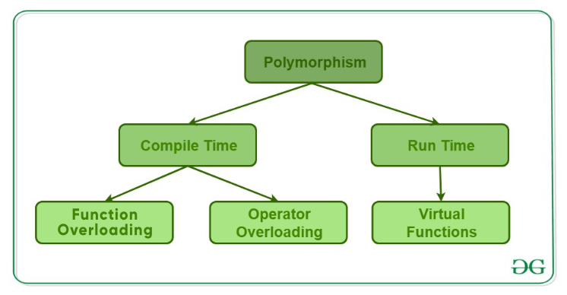
Polymorphism
In C++ polymorphism is mainly divided into two types:
Compile time Polymorphism
Runtime Polymorphism
(Dynamic Binding)
(Static Binding)

Slide 16
Polymorphism – Compile Time Polymorphism
Compile time polymorphism: This type of polymorphism is achieved by
function overloading
operator overloading.
Function Overloading:
In C++, two or more functions can have the same name if the number and/or type of arguments passed is different.
These functions having the same name but different arguments are known as overloaded functions.
E.g.
int test() { }
int test(int a) { }
float test(double a) { }
int test(int a, double b) { }

Slide 17
Function Overloading Example
Class Addition
{
Void add(int n1, int n2)
{
cout << “Addition of Integer ” << (n1+n2);
}
Void add(double s1, double s2)
{
Cout << “Addition of Float ” << (s1+s2);
}
};
Void main()
{
Addition obj;
Obj.add(12,13);
Obj.add(2.3,4.5);
}

Slide 18
Compile Time Polymorphism – Operator Overloading
In C++, we can change the way operators work for user-defined types
This means C++ has the ability to provide the operators with a special meaning for a data type, this ability is known as operator overloading.
For example, we can overload an operator ‘+’ in a class like String so that we can concatenate two strings by just using +.
Overloaded operators are functions with special names: the keyword "operator" followed by the symbol for the operator being defined.
Like any other function, an overloaded operator has a return type and a parameter list.

Slide 19
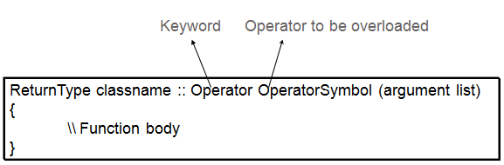
Operator Overloading Syntax
Return type – return type of function
Operator - is a keyword
Operatorsymbol is the operator we want to overload. Like: +, <, -, ++, etc.
arguments is the arguments passed to the function.

Slide 20
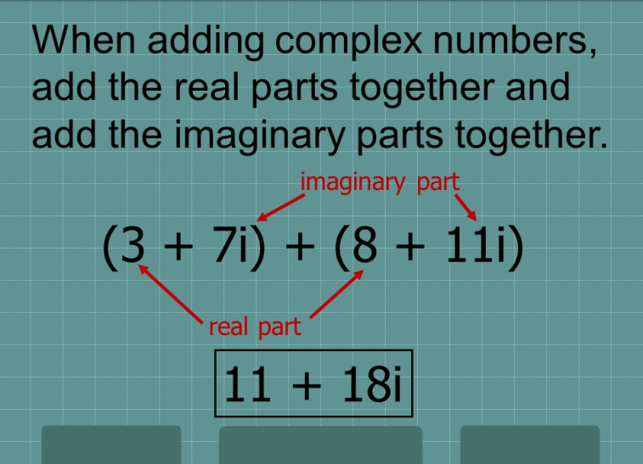
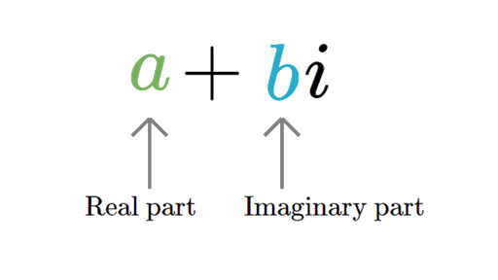
Operator Overloading - Example
Complex Number

Slide 21
Operator Overloading - Example
Class Complex
{
int real, img;
public:
Complex (int r, int i)
{
real = r; img = I;
}
void show()
{
cout << real << “ + “ << img << “i”;
}
};
Void main()
{
Complex c1(2,3),c2(3,4);
c1.show();
c2.show();
}

Slide 22
Implementing Operator Overloading
Operator overloading can be done by implementing a function which can be :
Member Function
Friend Function

Slide 23
Operator Overloading
Types of Operator
Unary operator – requires one operand
E.g.
Int a = 25;
a++ , ++a, a--, --a, +a, -a etc
Binary operator – requires 2 operand
E.g. int a = 5, b = 6
a+b, a-b, a*b, a/b etc.

Slide 24
No of Arguments for Operator Overloading
Type of Operator | Using Member Function | Using Friend Function
Unary Operator (1 operand) | No Argument | One Argument
Binary Operator (2 operand) | One Argument | Two Argument
C1.add(c2) // c1+c2 // c1.+(c2)
C1.incr() // c1++ // c1.++()

Slide 25
(Binary) Operator Overloading Example1
Class Complex
{
int real, img;
public:
Complex()
{
real=img=0;
}
Complex(int r, int i)
{real = r; img = I;}
Complex operator + (Complex c2)
{
Complex c;
c.real = real + c2.real;
c.img = img + c2.img;
return (c);
}
void show()
{
cout << real << “ + “ << img <<“I”;
}
}
Void main()
{
Complex c1(2,3),c2(4,5),c3;
c3 = c1 + c2; // c3 = c1.+(c2)
C3.show();
}
Int a=4,b=6;
int res = a+b;
Cout << res;

Slide 26
(Unary) Operator Overloading Example2
class Count {
private: int v1,v2;
public:
Count() {
v1= 5;v2=6}
void operator ++ () {
V1 = ++v1;
V2 = ++v2;
}
void display() {
cout << "Count values : " << v1 << v2 << endl;
} };
int main() {
Count count1;
Count1.display(); // 5 6
++count1;
count1.display(); // 6 7
return 0; }
Int a = 5;
a++;
a--;
Count ob1;
Ob1++;
Ob1--;

Slide 27
(Unary) Operator Overloading Example3
Negate the value using unary ‘ – ‘ operator
class Number {
int a, b;
public:
Number(int x, int y) {
a = x; b =y;
}
void operator –() {
a = -a;
b = - b;
}
void show(){
cout << “ Value of a” << a <<“ value of b”<< b;
} };
Void main(){
Number n1;
-n1;
n1.show()
}
Int a = 5;
-a; //-5

Slide 28
Operator overloading using friend function
Class Complex
{
int real, img;
public:
Complex()
{
real=img=0;
}
Complex(int r, int i)
{real = r; img = I;}
friend Complex operator + (Complex c1, Complex c2)
{
Complex c;
c.real = c1.real + c2.real;
c.img = c1.img + c2.img;
return (c);
}
void show()
{
cout << real << “ + “ << img <<“I”;
}
}
Void main()
{
Complex c1(2,3),c2(4,5),c3;
c3 = c1 + c2; // c3 = +(c1, c2)
C3.show();
}

Slide 29
(Unary) Operator Overloading using friend function
Negate the value using unary ‘ – ‘ operator
class Number {
int a, b;
public:
Number(int x, int y) {
a = x; b =y;
}
friend void operator –(Number n) {
n.a = -n.a;
n.b = - n.b;
}
void show(){
cout << “ Value of a” << a <<“ value of b”<< b;
} };
Void main(){
Number n1;
-n1;
n1.show()
}

Slide 30
Rules of Operator Overloading
Only existing operators can be overloaded (*/)
Basic meaning of the operator should remain the same.
Overloaded operators follow the same syntax as of original operator op1 + op2
Unary operator overloaded by means of member function accept no parameter
Unary operator overloaded by means of friend function accept one parameter
Binary operator overloaded by means of member function accept one parameter
Binary operator overloaded by means of friend function accept two parameter

Slide 31
Rules of Operator Overloading
Some of operator cannot be overloaded
Sizeof()
Member operator(.)
Pointer to member operator(.*)
Scope resolution operator(::)
Conditional Operator(?:)
Some of the operator cannot be overloaded with friend function
Assignment operator(=)
Function call operator()
Subscripting operator([])
Class member access operator(->)

Slide 32
Runtime Polymorphism – Function Overriding
class Base{
public: void display() {
cout << "In the base class";
}};
class Derived: public Base{
public:
void display() {
cout << "In the derived class";
}};
int main() {
Base ob;
Derived ob1;
ob1.display();
}

Slide 33
Runtime Polymorphism – Function Overriding
int main() {
Base *bptr,ob;
Derived ob1;
bptr = &ob;
bptr -> display();
bptr =&ob1;
bptr -> display();
}

Slide 34
Runtime Polymorphism – virtual function
To make a member function virtual, the keyword virtual is used in the methods while it is declared in the class definition but not in the member function definition.
The keyword virtual precedes the return type of the function name.
The compiler gets information from the keyword virtual that it is a virtual function and not a conventional function declaration.

Slide 35
Syntax
virtual return_type function_name1 (arguments);

Slide 36
Virtual Function Example
class Base{
public: virtual void display();
};
void Base::display(){
cout << "\n From the Base class";
}
class Derived: public Base{
public: void display() {
cout << "\nIn the derived class";
}};
class Derived1:public Base{
public: void display() {
cout << "\nIn the derived1 class";
}};
int main() {
Base *bptr, bobj;
Derived dobj;
Derived1 dobj1;
cout << "\nAddress of base class";
bptr = &bobj;
bptr -> display();
cout << "\nAddress of Derived class";
bptr = &dobj;
bptr -> display();
bptr = &dobj1;
bptr -> display();
}

Slide 37
Example Virtual Function
Shape * ptr;
Traingle t;
Rectangle r;
Ptr = &t;
Ptr - > area();
Ptr = &r;
Ptr -> area();
Shape
Virtual void area(int a,int b)
{
}
Triangle
Void area(int a, int b)
{
Cout << “Area ” << (a*b);
}
Rectangle
Void area(int a, int b)
{
cout << “Area ” << (a * b );
}

Slide 38
Program
class Shape{
protected: int d1,d2;
public: void get() {
cout << "\nEnter dim1 : " ;
cin >> d1;
cout << "\nEnter dim2 : " ;
cin >> d2;
}
virtual void area() {
cout << "Area in shape";
}};

Slide 39
class Triangle : public Shape{
public: void area() {
cout << "\nArea of Triangle "<< (0.5*d1*d2);
}};
class Rectagle :public Shape{
public: void area() {
cout << "\n Area of Rectangle "<< (d1*d2);
}};

Slide 40
int main(){
Shape *s;
Triangle t;
Rectagle r;
s = &t;
s->get();
s->area();
s = &r;
s->get();
s->area();
}

Slide 41
Prog Version 1
class Shape{
protected: int d1,d2;
public: void get() {
cout << "\nEnter dim1 : " ;
cin >> d1;
cout << "\nEnter dim2 : " ;
cin >> d2;
}
virtual void area() { } // Make function empty
};

Slide 42
Prog Version 2 (Pure Virtual function)
class Shape{
protected: int d1,d2;
public: void get() {
cout << "\nEnter dim1 : " ;
cin >> d1;
cout << "\nEnter dim2 : " ;
cin >> d2;
}
virtual void area() = 0; // pure virtual function
};

Slide 43
Pure Virtual function
A virtual function is not used for performing any task. It only serves as a placeholder.
When the function has no definition, such function is known as "do-nothing" function.
The "do-nothing" function is known as a pure virtual function. A pure virtual function is a function declared in the base class that has no definition relative to the base class.
A class containing the pure virtual function cannot be used to declare the objects of its own (pointer/reference of abstract class can be created), such classes are known as abstract base classes.
The main objective of the base class is to provide the traits to the derived classes and to create the base pointer used for achieving the runtime polymorphism.
Syntax –
virtual return type func_name(parameter) = 0;

Slide 44
Rules for virtual function
Virtual functions cannot be static and also cannot be a friend function of another class.
Virtual functions should be accessed using pointer or reference of base class type to achieve run time polymorphism.
The prototype(syntax) of virtual functions should be same in base as well as derived class.
They are always defined in base class and overridden in derived class. It is not mandatory for derived class to override (or re-define the virtual function), in that case base class version of function is used.
A class may have virtual destructor but it cannot have a virtual constructor.

Slide 45
Difference between function overloading and function overriding
Function Overloading | Function Overriding
Functions have same name but different number or different type of parameters. | Functions have same name ,same number and same type of parameters.
Overloading of the functions take place at compile time. | Overriding of the functions take place at run time.
It is also known as compile time polymorphism. | It is also known as run time polymorphism.
The functions that are overloaded are present in same class. | The functions that are overridden are present in different class.
It can occur without inheritance. | It cannot occur without inheritance.

Slide 46
Function Overloading | Function Overriding
Example: Void sum(double a, double b) { cout << “Addition ” << (a+b); } Void sum(int a, int b) { cout << “Addition “ << (a+b); } Void main() { Sum(2.2,3.4); Sum(2,3); } | Example: Class Base{ Public: Virtual void show(){ Cout << “ In Base class”; }}; Class Derived: public Base{ public: Void show(){ Cout << “In the derived class”; }}; Void main(){ Base *bptr, obj; Derived obj1; Bptr = &obj; Bptr - > show(); Bptr = &obj1; Bptr ->show();

Slide 47
Difference between Compile time polymorphism and runtime polymorphism
SR.NO | COMPILE TIME POLYMORPHISM | RUN TIME POLYMORPHISM
1 | In Compile time Polymorphism, the call is resolved by the compiler. | In Run time Polymorphism, the call is not resolved by the compiler.
2 | It is also known as Static binding, Early binding and overloading as well. | It is also known as Dynamic binding, Late binding and overriding as well.
3 | Method overloading is the compile-time polymorphism where more than one methods share the same name with different parameters or signature and different return type. | Method overriding is the runtime polymorphism having same method with same parameters or signature, but associated in different classes.
4 | It is achieved by function overloading and operator overloading. | It is achieved by virtual functions and pointers.

Slide 48
SR.NO | COMPILE TIME POLYMORPHISM | RUN TIME POLYMORPHISM
5 | It provides fast execution because the method that needs to be executed is known early at the compile time. | It provides slow execution as compare to early binding because the method that needs to be executed is known at the runtime.
6 | Compile time polymorphism is less flexible as all things execute at compile time. | Run time polymorphism is more flexible as all things execute at run time.

